Slide 1
Computer Organization and Architecture (AT70.01)
Comp. Sc. and Inf. Mgmt.
Asian Institute of Technology
Instructor: Dr. Sumanta Guha
Slide Sources: Based on CA: aQA by Hennessy/Patterson. Supplemented from various freely downloadable sources

Slide 2
Advanced Topic:
Dynamic Scheduling with Tomasulo’s Algorithm
CA:aQA Secs. 3.1-3.3

Slide 3
Data Hazards Review
RAW (read after write) hazard:
  instruction I occurs before instruction J in the program but…
  …instruction J tries to read an operand before instruction I writes to it, so J incorrectly gets the old value
  Example:
  …
  I: LW R1, 0(R2)
  …
  J: DADDU R3, R1, R4
  …
A RAW hazard is a true data dependence, where there is a programmer-mandated flow of data from one instruction (the producer) to another (the consumer)
  therefore, the consumer must wait for the producer to finish computing and writing
Note: see CA:aQA Sec. 2.12
for MIPS64 ISA information

Slide 4
Data Hazards Review
WAW (write after write) hazard:
  instruction I occurs before instruction J in the program but…
  …instruction J tries to write an operand before instruction I writes to it, so the wrong order of writes causes the destination register to end up with the value from I rather than that from J
  Example:
  …
  I: DSUBU R1, R2, R3
  …
  J: DADDU R1, R3, R4
  …
A WAW hazard is a not a true data dependence, but rather a kind of name dependence, called output dependence , because of the (avoidable?) same name of the destination registers
WAW hazards cannot occur in the classic 5-stage MIPS integer pipeline. Why…?
  registers are written only in one stage, the WB stage, and
  instructions enter the pipeline in order
However, we shall deal with situations where instructions may be executed out of order…

Slide 5
Data Hazards Review
WAR (write after read) hazard:
  instruction I occurs before instruction J in the program but…
  …instruction J tries to write an operand before instruction I reads it, so I incorrectly gets the later value
  Example:
  …
  I: DSUBU R2, R1, R3
  …
  J: DADDU R1, R3, R4
  …
A WAR hazard is a not a true data dependence, but rather a kind of name dependence, called antidependence, because of the (avoidable?) shared name of two registers
WAR hazards cannot occur in the classic 5-stage MIPS integer pipeline. Why…?
  registers are read early and written late
  instructions enter the pipeline in order
However, we shall deal with situations where instructions may be executed out of order…

Slide 6
Why Dynamic Scheduling…?
Static pipeline
scheduling
Data
Hazard
Yes
Bypass
possible
Yes
Bypass or
Forwarding
No
No
Pipeline
processing
Stall
instruction
Stall
instruction
Dynamic scheduling
reduces this stall via
ILP: Instruction Level Parallelism
Goal of ILP: To get as many instructions as possible executing
in parallel while respecting dependencies

Slide 7
Dynamic Scheduling:
Key Ideas
Old paradigm (classic MIPS 5-stage integer pipeline):
  in-order instruction issue and execution
  can cause unnecessary delay of instructions that also wastes hardware resources by keeping them idle through the delay
  e.g.,
  DIV.D F0, F2, F4
  ADD.D F6, F0, F8 # ADD.D and S.D are stalled by
  S.D F6, 0(R1) # true data dependences
  SUB.D F8, F10, F14 # SUB.D and MUL.D are ready to execute
  MUL.D F6, F10, F8 # but blocked by previous stalls!

Slide 8
Dynamic Scheduling:
Key Ideas
New paradigm:
  in-order issue but allow out-of-order execution (i.e., ILP = parallel execution of instructions) and, therefore, out-of-order completion
  e.g.,
  DIV.D F0, F2, F4
  ADD.D F6, F0, F8
  S.D F6, 0(R1)
  SUB.D F8, F10, F14
  MUL.D F6, F10, F8
  without waiting for ADD.D and S.D to complete execution try to execute SUB.D and MUL.D
  this out-of-order execution raises two potential hazards that do not exist in the classic pipeline with in-order execution
    WAR hazard: the antidependence between ADD.D and SUB.D
    WAW hazard: the output dependence between ADD.D and MUL.D

Slide 9
Dynamic Scheduling:
Key Ideas
  solution: eliminate WAR and WAW hazards by register renaming
  e.g.,
  DIV.D F0, F2, F4
  ADD.D F6, F0, F8
  S.D F6, 0(R1)
  SUB.D F8, F10, F14
  MUL.D F6, F10, F8
  Tomasulo provides register renaming via reservation stations
    reservation stations fetch and buffer an operand as soon as it is available, eliminating need to go to register to get operand
    pending instructions designate reservation stations that will provide input values
    results are passed directly from functional units where they are computed to the reservation stations where they are required over the common data bus (CDB) – bypassing registers
S
S
T
T

Slide 10
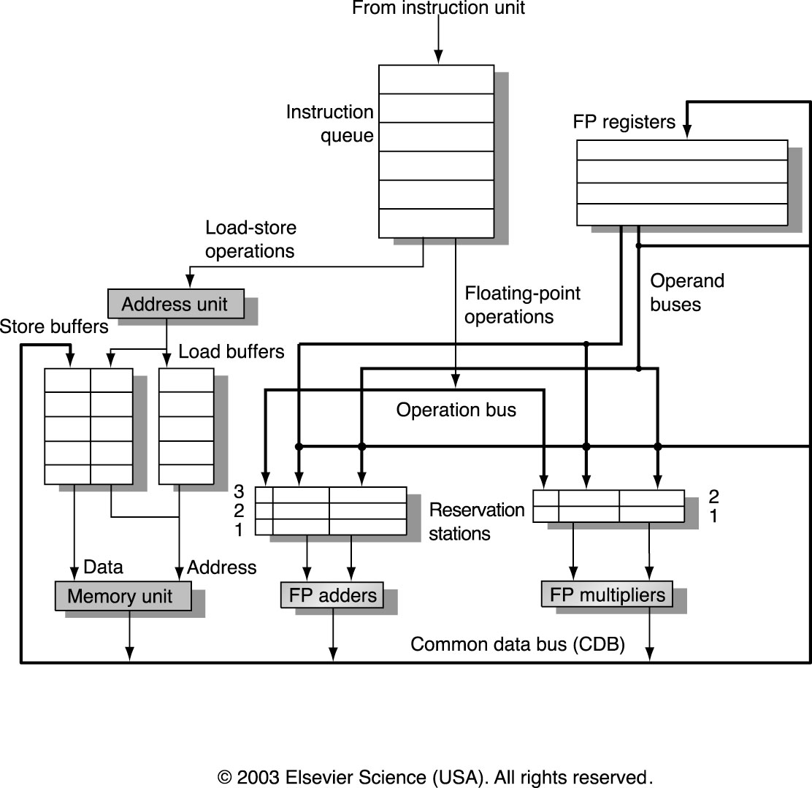
Tomasulo’s
Algorithm
Note: reservations
stations do not
form a queue! They
all have independent
access to FP op unit
Note: there may be
multiple or pipelined
FP op units –
conceptually same!
Basic structure of MIPS floating-point unit based on Tomasulo

Slide 11
Tomasulo’s Algorithm:
Three Stages
Issue: get instruction from Instruction Queue
  if reservation station free (no structural hazard),
  control issues instruction to reservation station, and sends to reservation station operand values (or reservation station source for values)
Execution: operate on operands (EX)
  when both operands ready then execute;
  if not ready, watch CDB for result
Write result: finish execution (WB)
  write on CDB to all awaiting units;
  mark reservation station available

Slide 12
Tomasulo’s Algorithm:
Data Structures
Reservation station fields
Op: Operation to be performed on source operands S1 and S2
Qj, Qk: The reservation stations that will produce the corresponding operand; value of 0 indicates source operand is already available in Vj or Vk, or is unnecessary
Vj, Vk: The value of the source operands. Only one of the V or Q fields is valid for each operand. For loads, Vk field holds offset
A: Holds information for the memory address calculation for load and store. Initially, immediate field of instruction is stored here; after address calculation, effective address is stored
Busy: Reservation station and related functional unit occupied
Register file field
Qi: Number of the reservation station that contains the operation whose results will be stored into this register; value of 0 (or blank) indicates value is register contents, i.e., no instruction targets this register

Slide 13
Examples
L.D F6, 34(R2)
L.D F2, 45(R3)
MUL.D F0, F2, F4
SUB.D F8, F2, F6
DIV.D F10, F0, F6
ADD.D F6, F8, F2
We run Tomasulo’s algorithm on the above code sequence in three different examples:
Data structures when the only the first load has completed
Data structures when MUL.D is about to write
Data structures cycle by cycle

Slide 14
Example A:
Instructions
Instruction Status
Instruction Issue Execute Write Results
L.D F6, 34(R2) X X X
L.D F2, 45(R3) X X
MUL.D F0, F2, F4 X
SUB.D F8, F2, F6 X
DIV.D F10, F0, F6 X
ADD.D F6, F8, F2 X
All instructions have issued but only the first L.D has completed and written its result

Slide 15
Example A:
Reservation Stations
Name Busy Op Vj Vk Qj Qk A
Load1 no
Load2 yes LOAD 45 + Regs[R3]
Add1 yes SUB Mem[34+Regs[R2]] Load2
Add2 yes ADD Add1 Load2
Add3 no
Mult1 yes MUL Regs[F4] Load2
Mult2 yes DIV Mem[34+Regs[R2]] Mult1
Addi indicates ith reservation station for the FP add unit, etc.

Slide 16
Example A:
Registers
Field F0 F2 F4 F6 F8 F10 F12……….F30
Qi Mult1 Load2 Add2 Add1 Mult2
Floating point registers

Slide 17
Notes
The CDB allows an operand to be broadcast as soon as its value is computed in a functional unit
  allows multiple instructions awaiting that value to be released simultaneously
WAW and WAR hazards are eliminated by renaming registers using reservation stations and by storing operands into reservation stations as soon as they become available. E.g., the WAR hazard between DIV.D and ADD.D involving F6 is eliminated in both cases:
  if the L.D instruction providing the 2nd operand of DIV.D has completed (case shown), then Vk stores the result, making DIV.D independent of ADD.D
  If the L.D instruction providing the 2nd operand of DIV.D has not completed, then Qk points to the Load1 reservation station, again making DIV.D independent of ADD.D

Slide 18
Notes
Instructions pass through the issue stage in order but can bypass one another in the execute stage and complete out of order.
Why must instructions issue in order?
  when an instruction issues to a free reservation station it looks up its operand registers for either the operand value itself (V value from the register’s data) or the reservation station that will produce the value (Q value from the register’s status field)
  additionally, the instruction will write its own reservation station number to its destination register’s status field
  now suppose instructions
  SUB.D F2, F4, F6
  ADD.D F8, F2, F4
  issue in order. How is the F2 register’s status field set and how are the ADD.D reservation station’s Q and V fields set?
  what happens if the instructions are issued in reverse order?!
See CA: aQA Fig. 3.5 for algorithm details of Tomasulo

Slide 19
Example B:
Instructions
Instruction Status
Instruction Issue Execute Write Results
L.D F6, 34(R2) X X X
L.D F2, 45(R3) X X X
MUL.D F0, F2, F4 X X
SUB.D F8, F2, F6 X X X
DIV.D F10, F0, F6 X
ADD.D F6, F8, F2 X X X
When MUL.D is about to write

Slide 20
Example B:
Reservation Stations
Name Busy Op Vj Vk Qj Qk A
Load1 no
Load2 no
Add1 no
Add2 no
Add3 no
Mult1 yes MUL Mem[45+Regs[R3]] Regs[F4]
Mult2 yes DIV Mem[34+Regs[R2]] Mult1
Addi indicates ith reservation station for the FP add unit, etc.

Slide 21
Example B:
Registers
Field F0 F2 F4 F6 F8 F10 F12……….F30
Qi Mult1 Mult2
Floating point registers

Slide 22
Latencies
Assume operation latencies
  load: 2 clock cycles
  add/sub: 2 clock cycles
  multiply: 10 clock cycles
  divide: 40 clock cycles

Slide 23
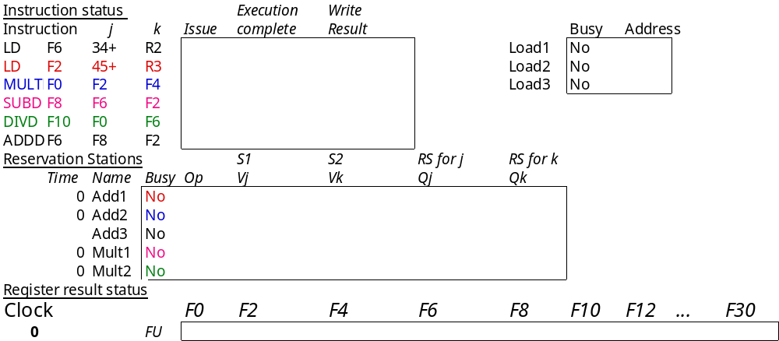
Example C: Cycle 0

Slide 24
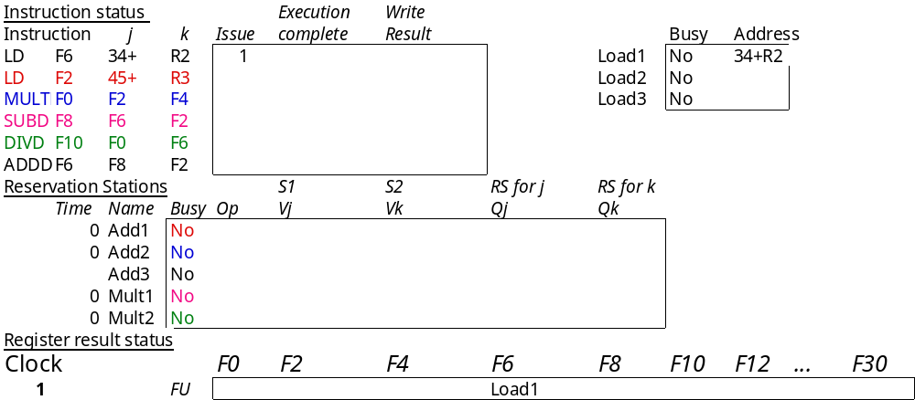
Example C: Cycle 1
Yes

Slide 25
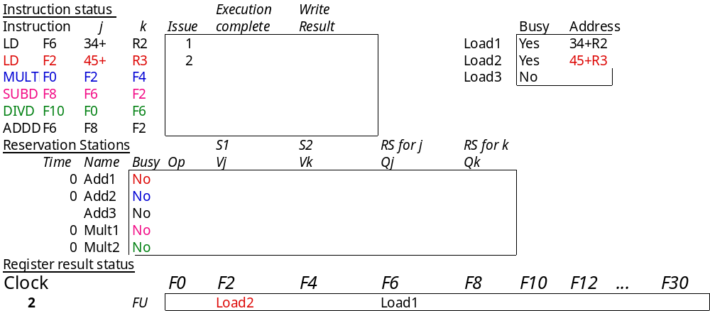
Example C: Cycle 2

Slide 26
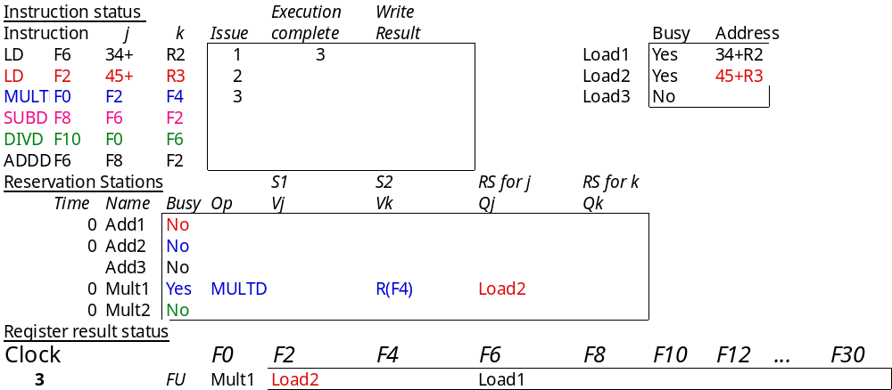
Example C: Cycle 3

Slide 27
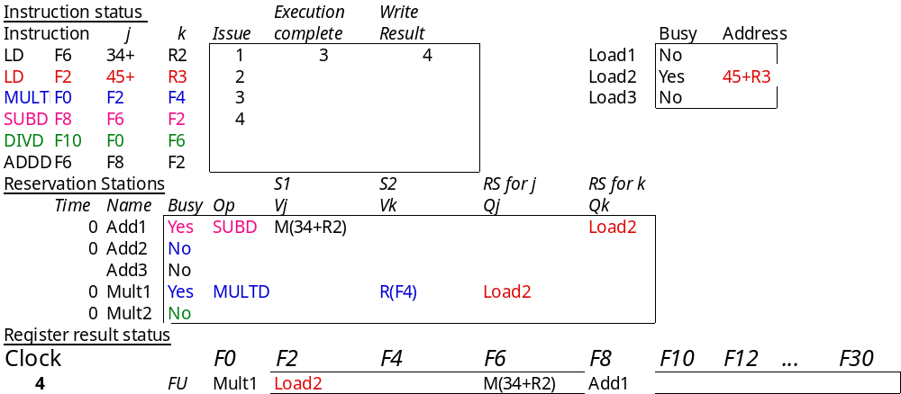
Example C: Cycle 4

Slide 28
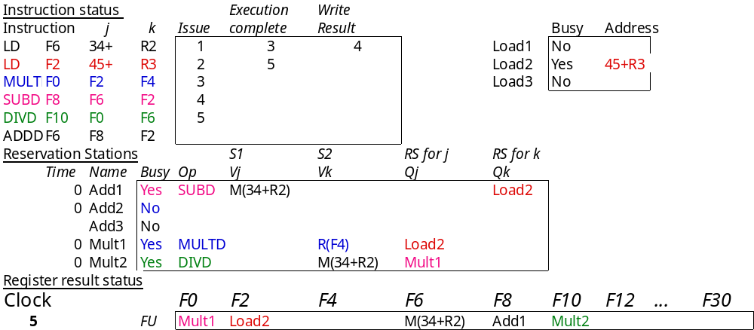
Example C: Cycle 5

Slide 29
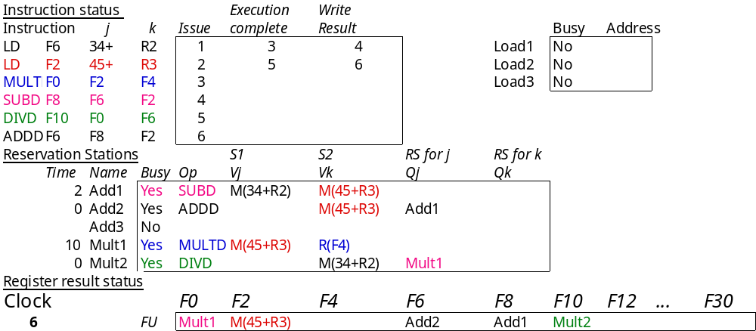
Example C: Cycle 6

Slide 30

Example C: Cycle 7

Slide 31
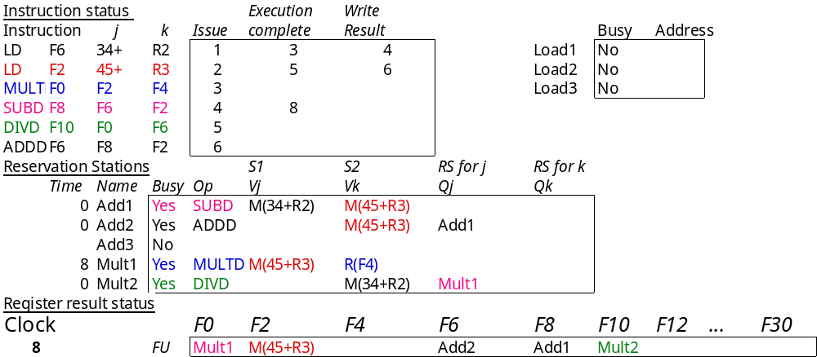
Example C: Cycle 8

Slide 32
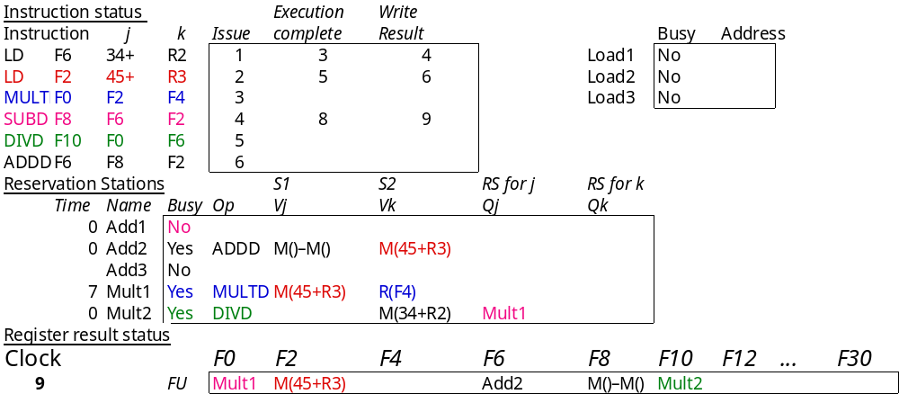
Example C: Cycle 9

Slide 33
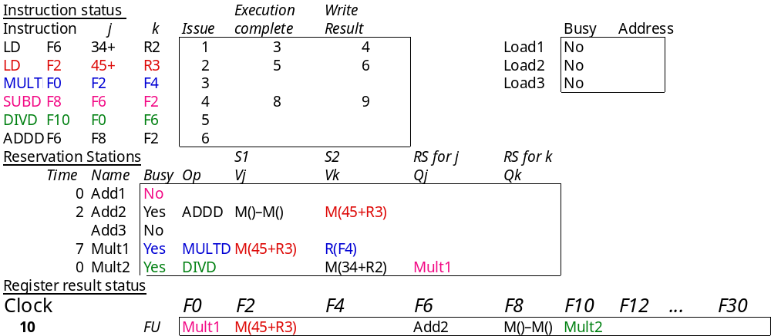
Example C: Cycle 10
6

Slide 34

Example C: Cycle 11

Slide 35
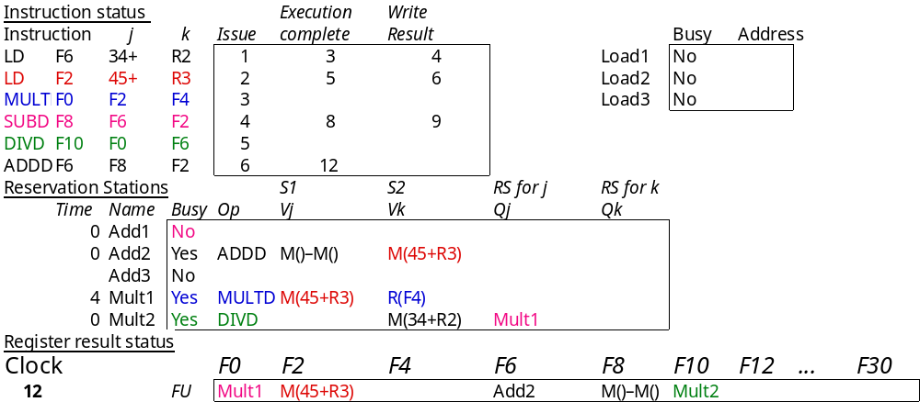
Example C: Cycle 12

Slide 36
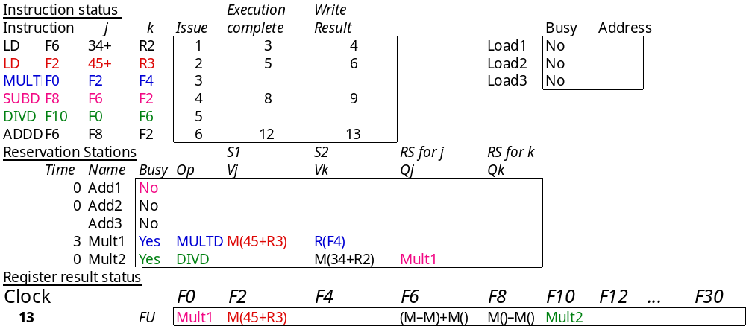
Example C: Cycle 13

Slide 37

Example C: Cycle 14

Slide 38

Example C: Cycle 15

Slide 39

Example C: Cycle 16

Slide 40
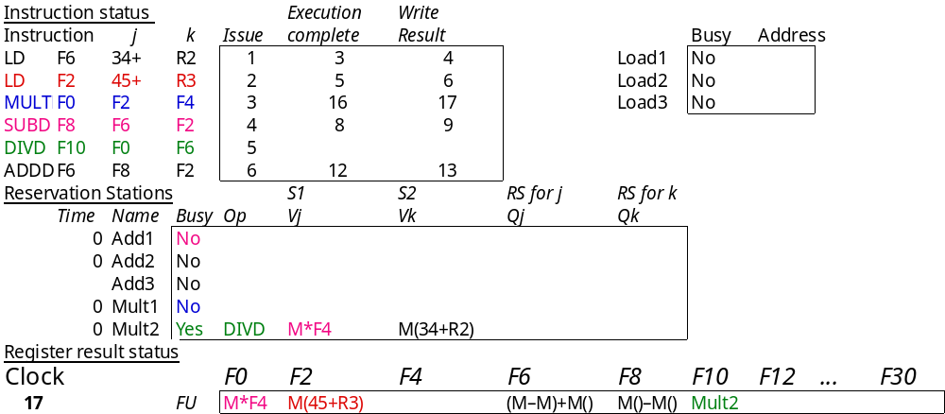
Example C: Cycle 17

Slide 41

Example C: Cycle 18

Slide 42

Example C: Cycle 57

Slide 43
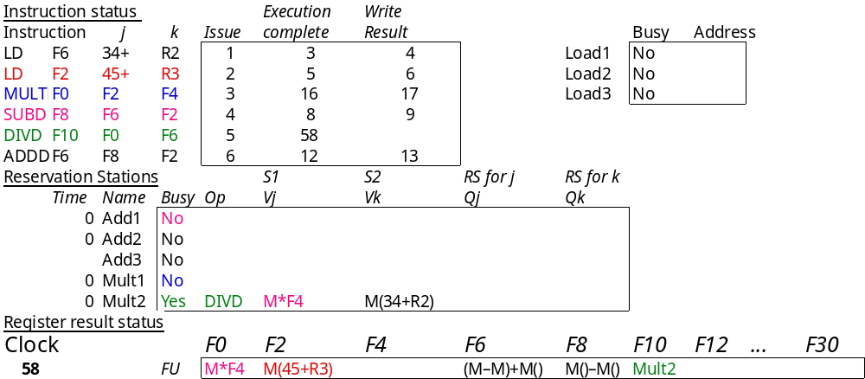
Example C: Cycle 58

Slide 44
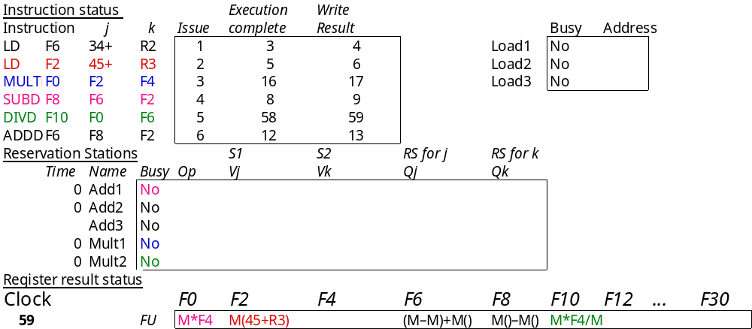
Example C: Cycle 59

Slide 45
Tomasulo Loop Example
Loop: LD F0 0 R1
MULTD F4 F0 F2
SD F4 0 R1
SUBI R1 R1 #8
BNEZ R1 Loop
Assume multiply takes 4 clocks
Assume first load takes 8 clocks (cache miss?), second load takes 4 clocks (hit)
To be clear, will show clocks for SUBI, BNEZ
Reality: integer instructions ahead

Slide 46
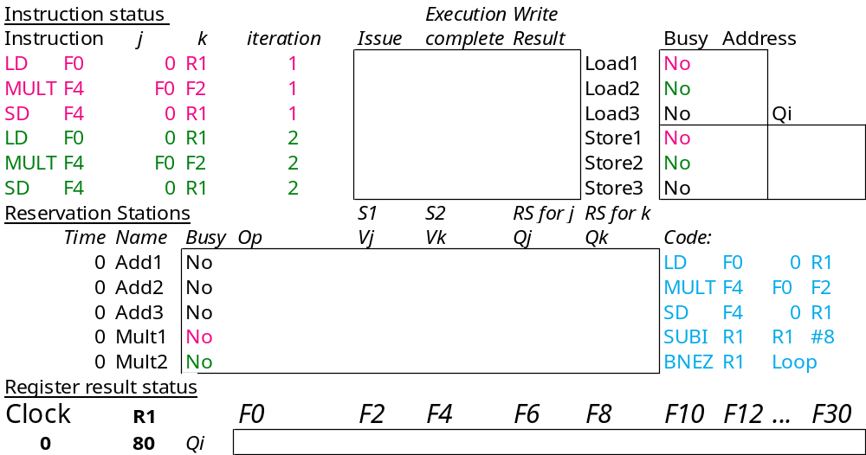
Loop Example Cycle 0

Slide 47
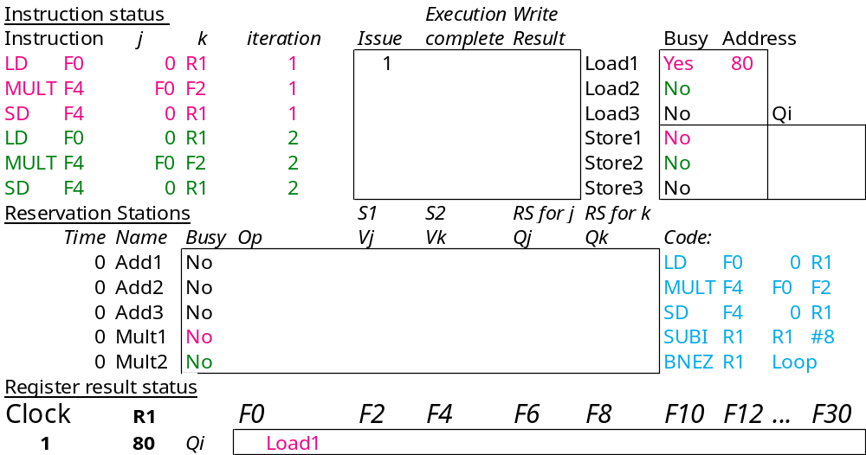
Loop Example Cycle 1

Slide 48
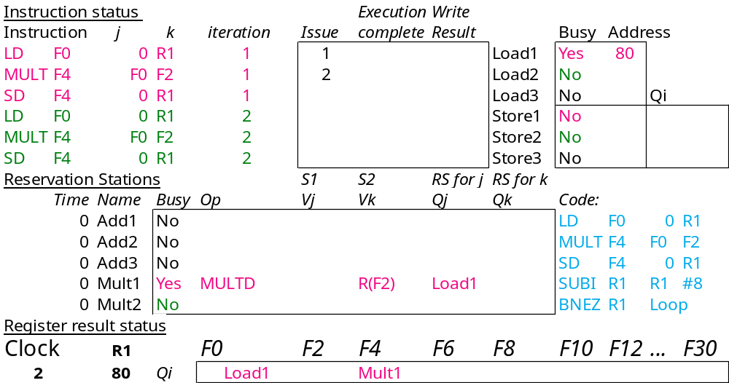
Loop Example Cycle 2

Slide 49
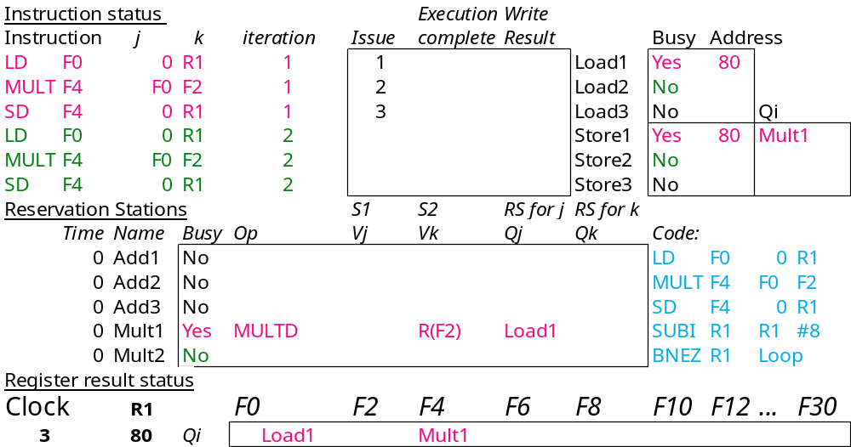
Loop Example Cycle 3
Note: MULT1 has no registers names in RS

Slide 50

Loop Example Cycle 4

Slide 51

Loop Example Cycle 5

Slide 52
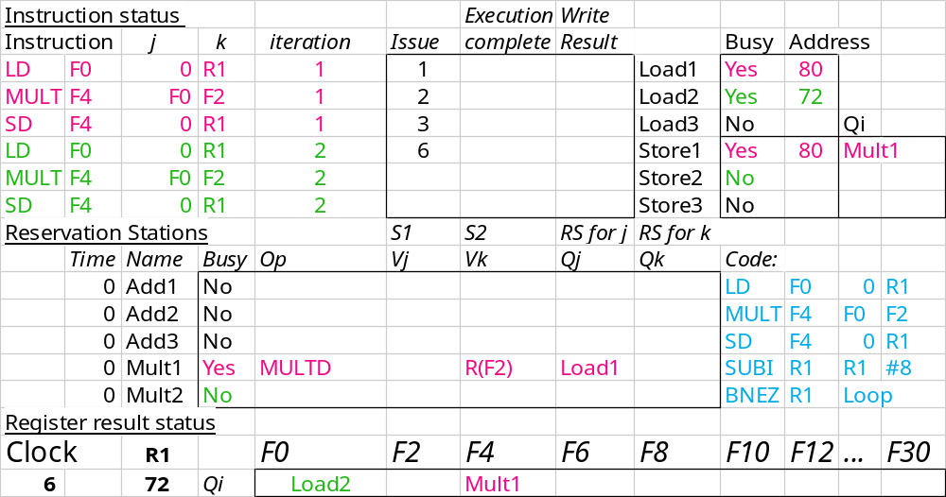
Loop Example Cycle 6
Note: F0 never sees Load1 result

Slide 53
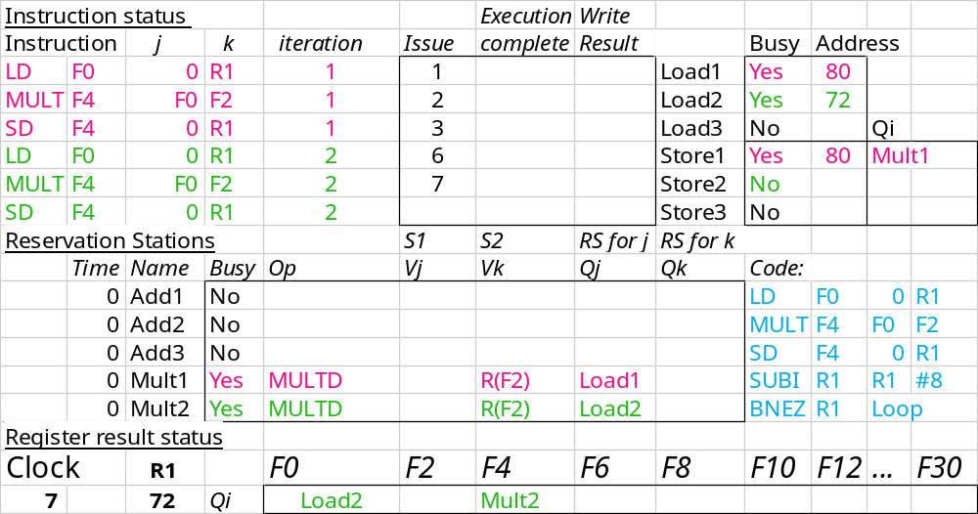
Loop Example Cycle 7
Note: MULT2 has no registers names in RS

Slide 54
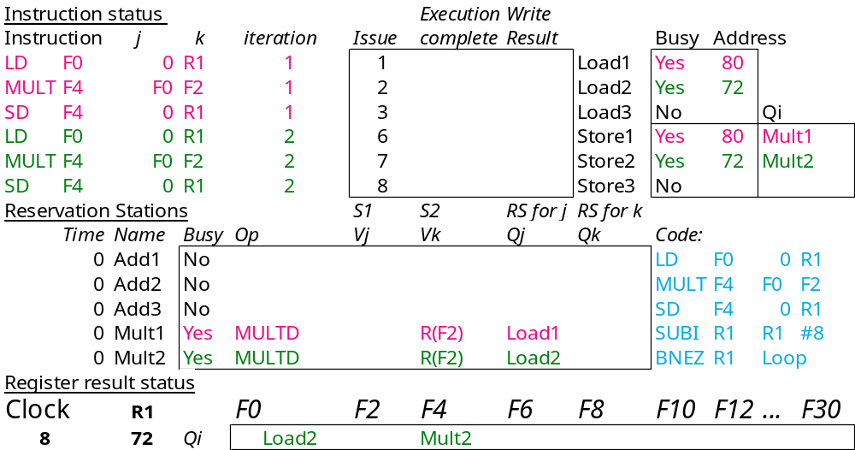
Loop Example Cycle 8

Slide 55
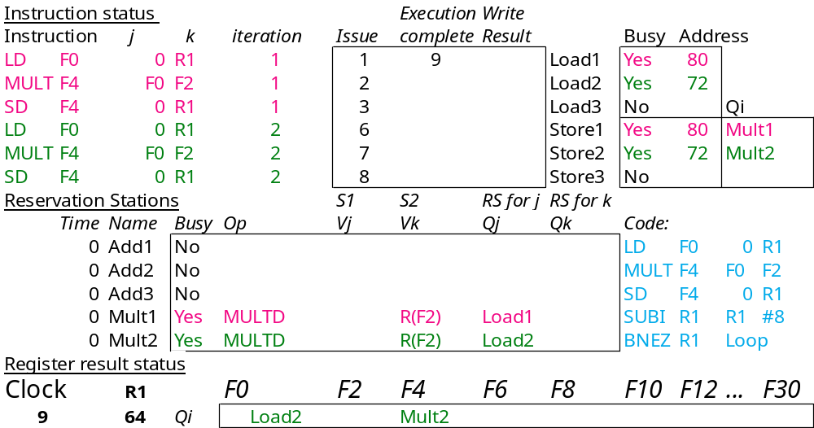
Loop Example Cycle 9
Load1 completing; what is waiting for it?

Slide 56
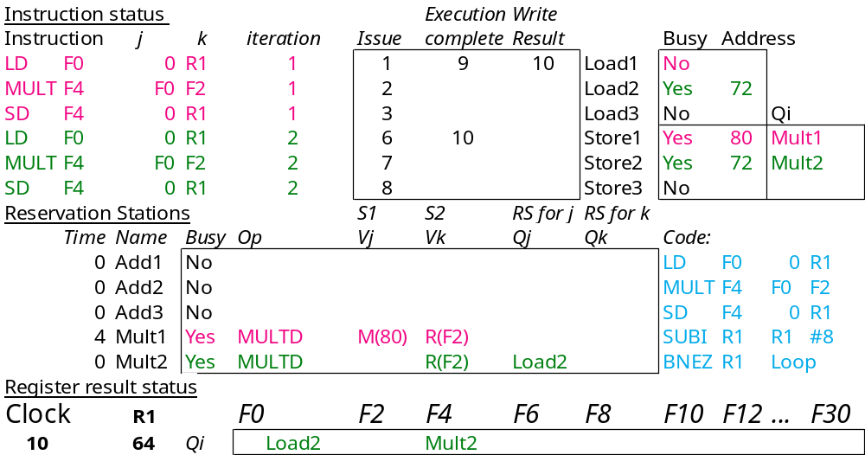
Loop Example Cycle 10
Load2 completing; what is waiting for it?

Slide 57
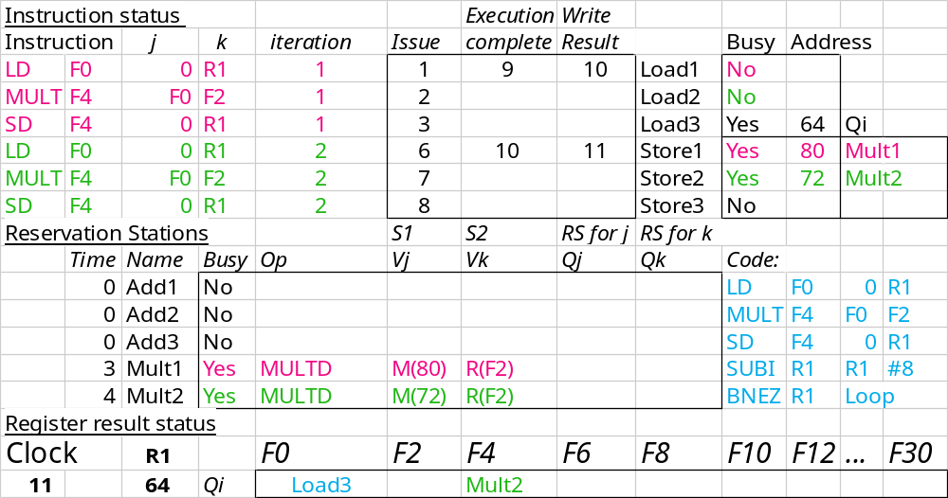
Loop Example Cycle 11

Slide 58

Loop Example Cycle 12

Slide 59

Loop Example Cycle 13

Slide 60
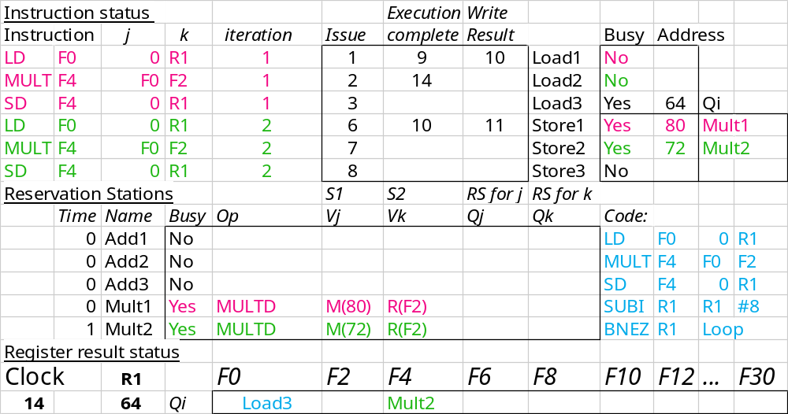
Loop Example Cycle 14
Mult1 completing; what is waiting for it?

Slide 61
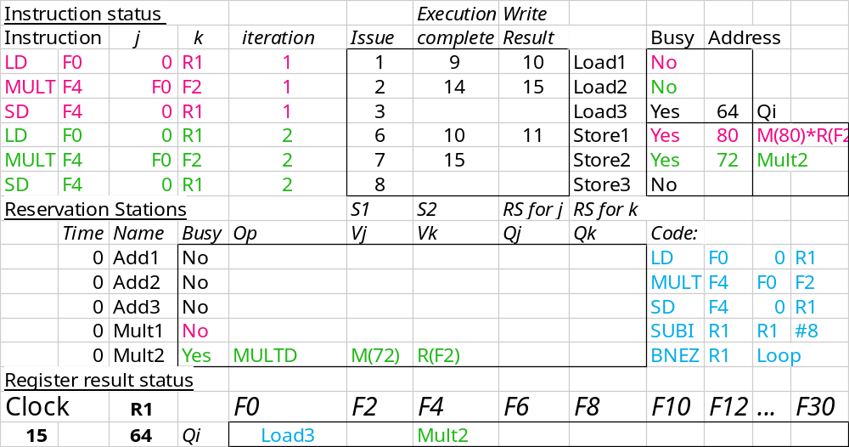
Loop Example Cycle 15
Mult2 completing; what is waiting for it?

Slide 62
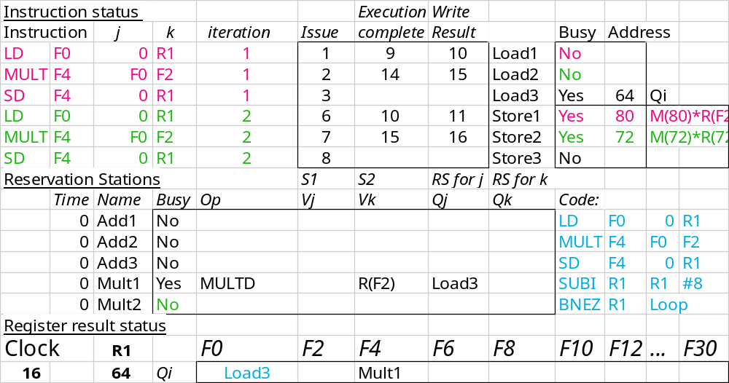
Loop Example Cycle 16

Slide 63
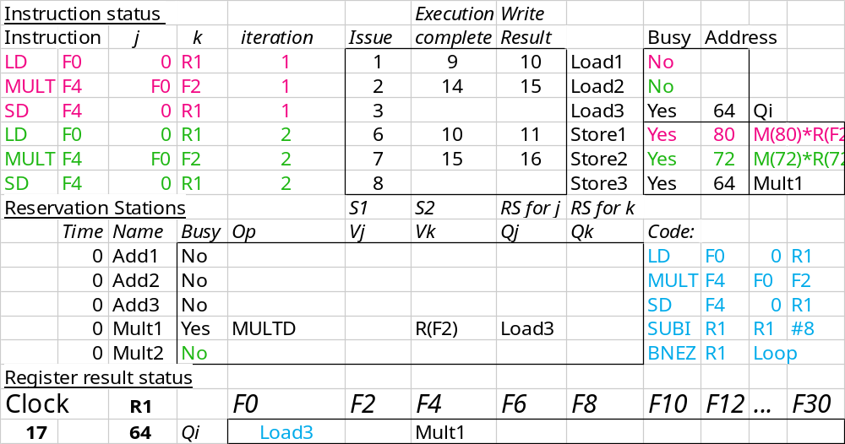
Loop Example Cycle 17

Slide 64

Loop Example Cycle 18

Slide 65
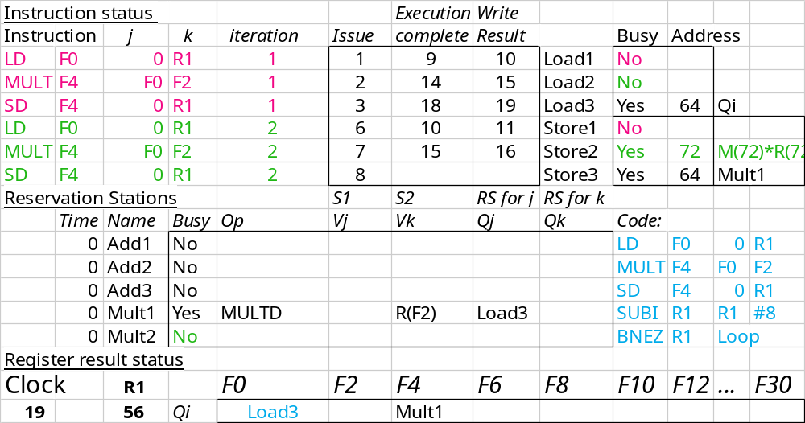
Loop Example Cycle 19

Slide 66

Loop Example Cycle 20

Slide 67
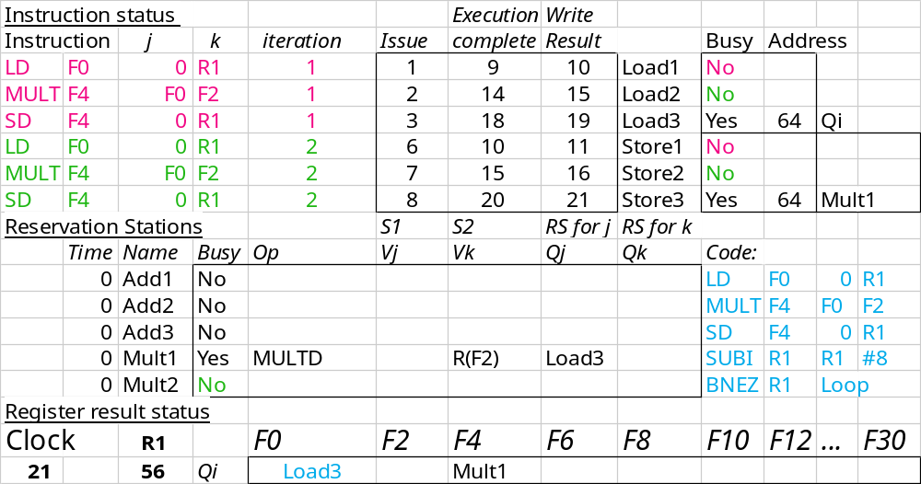
Loop Example Cycle 21

Slide 68
Tomasulo Summary
Advantages
  prevents registers from being the bottleneck
  eliminates WAR, WAW hazards
  allows loop unrolling in HW
  common data bus (CDB) broadcasts results to multiple instructions
Disadvantages
  hardware complexity
  performance limited by associative stores required from CDB to reservation stations
  performance limited by CDB bandwidth (CDB = bottleneck)
Lasting Contributions
  dynamic scheduling
  register renaming
  load/store disambiguation
Original Tomasulo implementation was on IBM 360/91
  famous modern descendants: Pentiums, PowerPCs, MIPS R10000,…

Slide 69
Notes
See Tomasulo simulations at our Additional Resources page
  webHase Tomasulo Simulation
  McGill University Tomasulo Simulation

